Slide 1
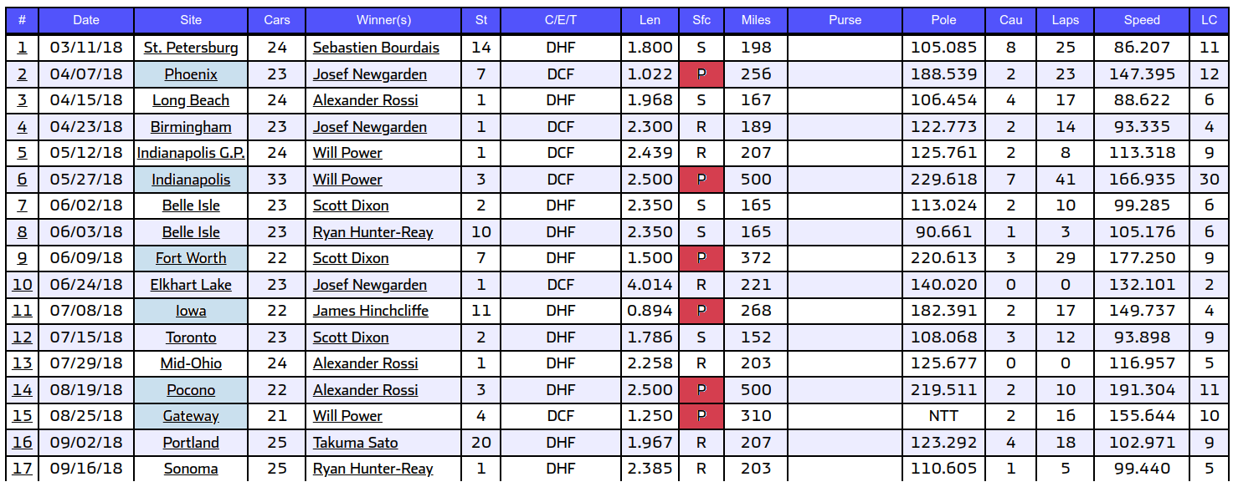
6 Oval Speedway Races in 2018 IndySeries
events_totalmiles=[256,500,372,268,500,310] events_laplen = [1.022,2.5,1.5,0.894,2.5,1.25] events = ['Phoenix','Indy500','Texas','Iowa','Pocono','Gateway']

Slide 2
Extract Stint Dataset
Stint: laps between consecutive pitstops event=Iowa, records=83 event=Phoenix, records=89 event=Indy500, records=189 event=Pocono, records=104 event=Gateway, records=83
event=Texas, records=95

Slide 3
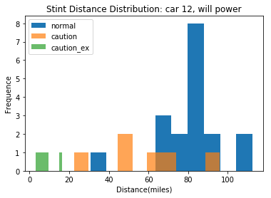
Stint Distance Distribution
Stint length
calculated by trackLength* lap_number
normal, pitstop in green flag lap
caution, pitstop in yellow flag lap
caution_ex, the length to current start lap of yellow flag(how much delay to go to pit stop when yellow flag raised)

Slide 4
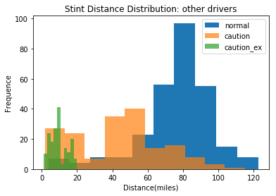
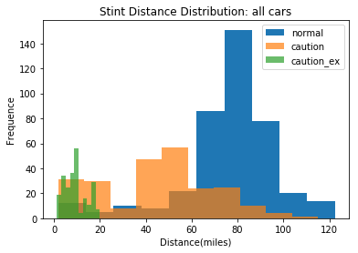
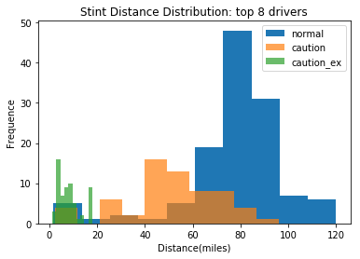
Comparison

Slide 5
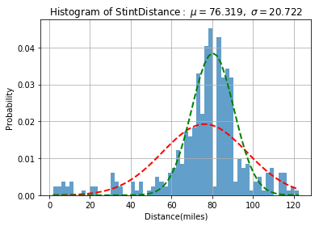
Fit to Normal Distribution
all cars
red line is the fit model
green line is N(u, sigma/2)

